Slide 1
Keep-it-fresh Bags
Testing of Tomatoes
www.keep-it-fresh.com

Slide 2
What happens after 7 days to a tomato stored in normal conditions of 68 F max and 45 F min

Slide 3
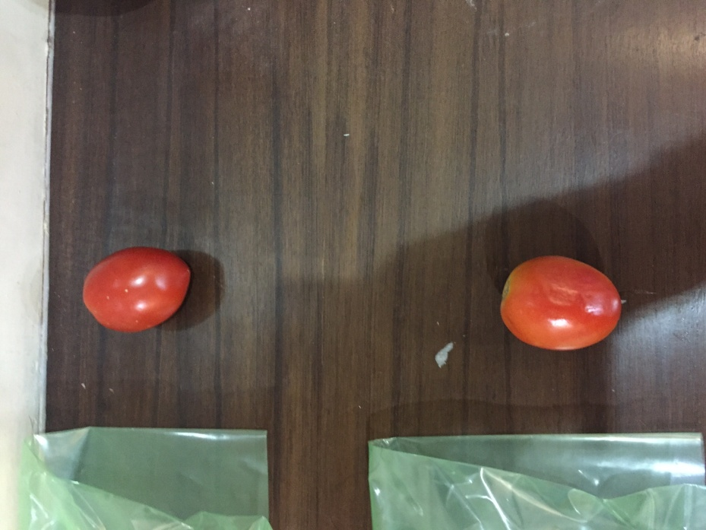
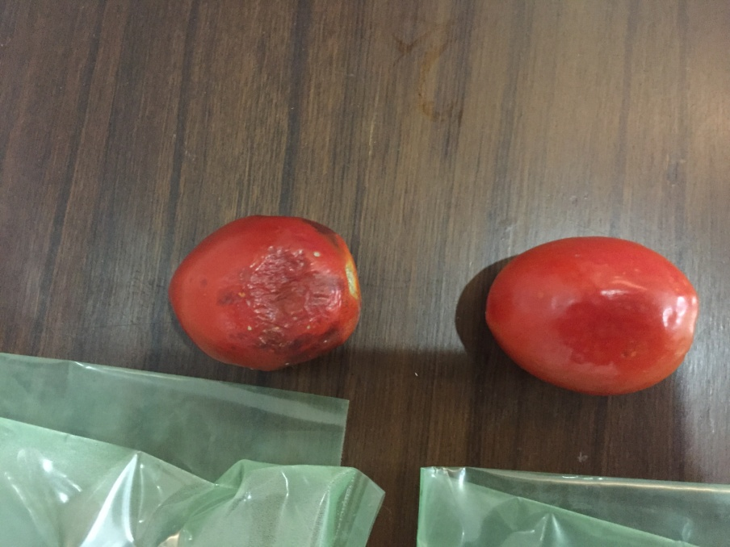
Tomatoes in open condition
Tomates Day 1
Tomates Day 7

Slide 4
What happens if the tomatoes are packed in normal bags ?

Slide 5
Plain Bags
Black spots observed on 3 tomatoes out of 4 in 7 days

Slide 6
Effect of KEEP-IT-FRESH Ethylene Absorbing Bags on the life of Tomatoes

Slide 7
Tomatoes packed in KEEP-IT-FRESH 6% film after 7 days
0 spots observed on any tomato after 7 days
Keep-it-fresh @ 6%
No Black Spots
Increases Life Increases Profits

Slide 8
Effect of Holes in the bags

Slide 9
Tomatoes used SF MB @ 6% with and without holes after 7 days
Keep-it-fresh MB @ 6%
Without holes
Black Spots
Keep-it-fresh MB @ 6% with holes
No Black Spots
The bags with holes are found to develop no black spots where as the ones without holes developed black spots on 2 pieces out of 4.
The holes allow for moisture to be breathed out, which prevents rotting and fungal growth

Slide 10
TOMATOES AFTER 12 DAYS OF PACKAGING IN KEEP-IT-FRESH COMPARED TO PLAIN BAGS

Slide 11
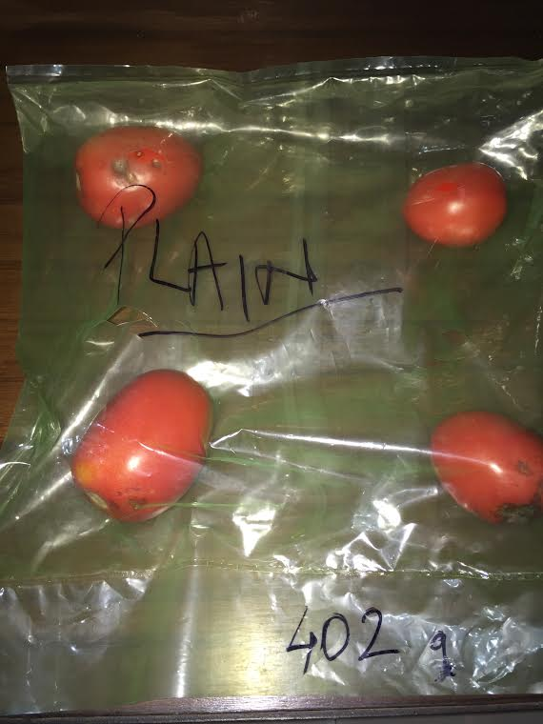
Tomatoes after 12 days in KEEP-IT-FRESH BAGS
ROT NOT@ 6%
Black Spots
PLAIN BAGS
Keep-it-fresh MB @ 6% with holes
No Black Spots
ROT NOT@ 6% with holes
No Black Spots
Plain Bags found to develop black spots on 3 tomatoes out of 4
No black spots or rotting found On keep-it-fresh bags @ 6% additive

Slide 12
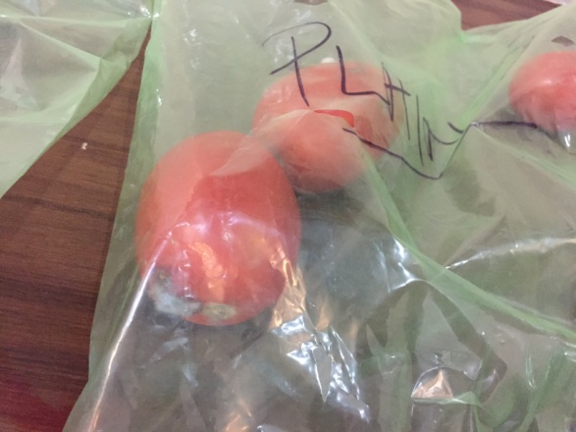
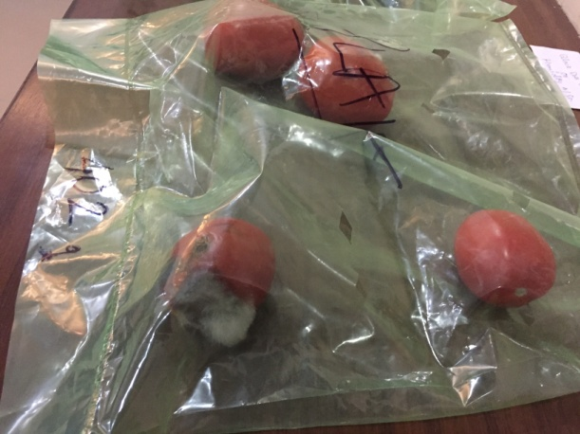
Tomatoes after 16 days in KEEP-IT-FRESH BAGS
Keep-it-fresh MB @ 6% with holes
1 Black Spots
PLAIN BAGS
PLAIN BAGS
Plain Bags found to develop fungal growth on day 16
1 black spot found on 1 tomato and others found ok for KEEP-IT-FRESH bag @ 6% additive

Slide 13
Results
Plain bags: Plain bags resulted in faster rotting of tomatoes
Effect of holes: Bags without holes also resulted in faster rotting of tomatoes
Bags with KEEP-IT-FRESH Additive @ 6% did not develop any black marks even after 12 days of storage where as the ones in normal bags rotted badly.
On the 16th day, Plain bags found to be full of fungal growth and mold where as in KEEP-IT-FRESH@ 6% bag only 1 tomato found to develop small black spot.
End of testing.

